Slide 1


Owning the Result
Taming the ACT
…unpacking the test and making it relevant
Page High School
ACT Initiative/2019-2020

Slide 2

From an Administrative standpoint…
The 5 ways to “C” the ACT
5Cs
Collect/Analyze Data

Slide 3
From an Administrative standpoint…
The 5 ways to “C” the ACT
5Cs
Clarify Goals

Slide 4
From an Administrative standpoint…
The 5 ways to “C” the ACT
Clarify Goals
College Course | Subject Test | Benchmark Score
English Composition | English | 18
Social Sciences | Reading | 22
College Algebra | Mathematics | 22
Biology | Science | 23
5Cs

Slide 5
From an Administrative standpoint…
The 5 ways to “C” the ACT
5Cs
Capacity – Build It!

Slide 6
From an Administrative standpoint…
The 5 ways to “C” the ACT
5Cs
Communicate
with Parents and Students

Slide 7
From an Administrative standpoint…
The 5 ways to “C” the ACT
5Cs
Celebrate Achievement!

Slide 8
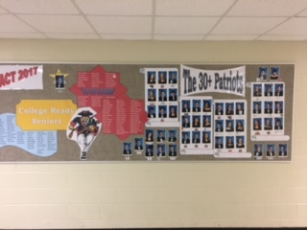
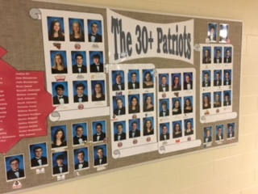
From an Administrative standpoint…
Celebrate Achievement!
English
Math
28
Reading
58
39
25
30
Science
School Goal

Slide 9
From an Administrative standpoint…
The 5 ways to “C” the ACT
Collect/Analyze Data
Clarify Goals
Capacity – Build It!
Communicate – Parents/Students
Collect/Analyze Data

Slide 10


What’s on tap today?
By the end of this session:
  You should understand the structure of the ACT
  You should understand what an ACT score means
  You should understand a basic approach to tame the ACT
  You should be able to access resources
  You should be able to understand how to help teachers prepare students for the test in the classroom

Slide 11

Some questions about the ACT...
What do we do about skill deficits?
Why does the ACT matter?
What are College Readiness Standards?
Are we just learning to take a test?
How do we help students navigate their way through the ACT subject tests?
What should students practice?
How do ACT’s priorities clash with modern culture?
Notes:
On this slide, the presenter should read the questions and discuss the limits of this program. This tutoring program will NOT answer all questions about the ACT. Rather, this program will help guide students through the process of unpacking the test and navigating through available resources. This might be a good time to reference the research information about College Readiness and ACT alignment/articulation with college expectations. That research can be accessed on www.act.org . . . Along with quite a bit of test prep information.

Slide 12

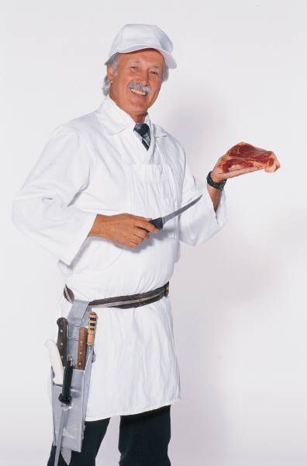

What we’ll try to do . . .
Expose the test – we can’t battle what we don’t know!
Reduce the test – the best way to eat an elephant: one bite at a time
Problem solve the hurdles
Notes:
If students are unfamiliar with the concept of an anchor chart, you might define that form them. Anchor Charts are simply thinking maps used while working through a problem. They serve as future reminders of how problems were analyzed. Many students and teachers find them helpful for reference during instruction or discussion. There is really no magic in the term “Anchor Chart,” so don’t be limited by the label. Just call them whatever seems practical for the students.

Slide 13
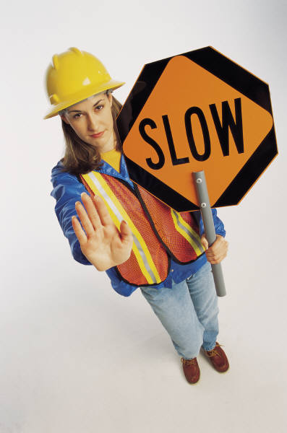
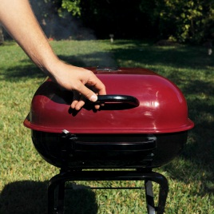
What we’re not expecting ...
Perfection – too lofty
Complete Digestion – too much to eat
Comprehensive Details – too much to cover
Content Mastery – too unrealistic
Barbeque Style . . .
Low and Slow!
Notes:
Be sure to remind them that we are not going to attempt to answer every lingering questions. We are going to expose the test and slowly, methodically dissect it.

Slide 14






Who ya gonna call?
Ken Stansberry – Page HS
kenneth.stansberry@wcs.edu
Cell: 865-640-4717

Slide 15



Where do we start?

Slide 16

















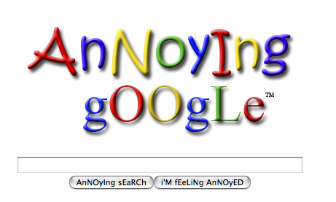




There’s just so much to know!
Let’s talk about this generation for a minute. It might impact the ACT
Notes:
We need to really stress the importance of working through problems and reading research about the test. Remind them that they live in a generation of externally stored information about myriad things. They have unfettered access to that information, but they have very little of it stored in their brains. The test does not assess their ability to access external information; it tests their internal problems solving strategies. That process is difficult, and it takes work. Remind them that they are entirely responsible for the amount of information they acquire for this test; they are not restricted to what we give them. There is a world of support out there. Time management and informed research will help them along the way. Remind them, if they don’t practice, they will never trust our strategies on test day. No place kicker kicks field goals on game day without ever practicing. It’s the practice that makes it natural and familiar. Anyone who has watched a football game knows that game day pressures would be far too much for an unpracticed kicker. A student’s brain will work with them much more efficiently on test day if it has been exposed to rigorous practice. That will require much more than just listening during these sessions.

Slide 17




Let’s talk score . . .
What does it really mean?
  36 = Bazinga!
  21 = National Average – HOPE Scholarship $
  01 = Come on! Really?

Slide 18
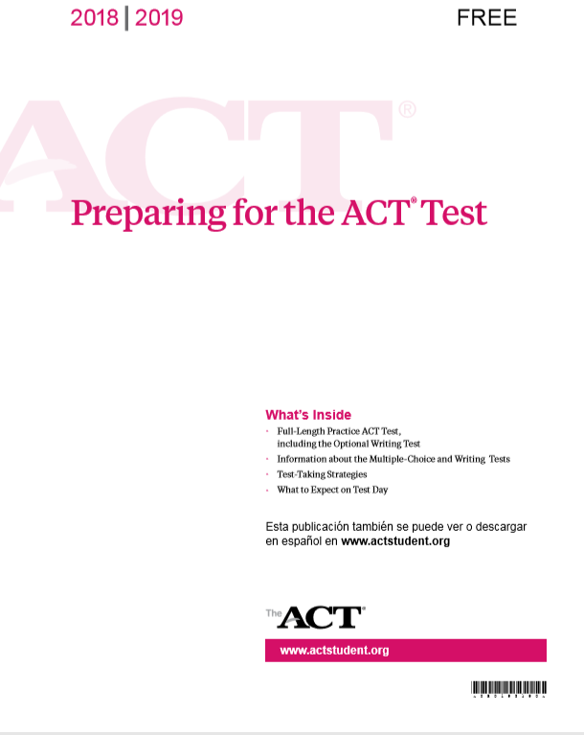
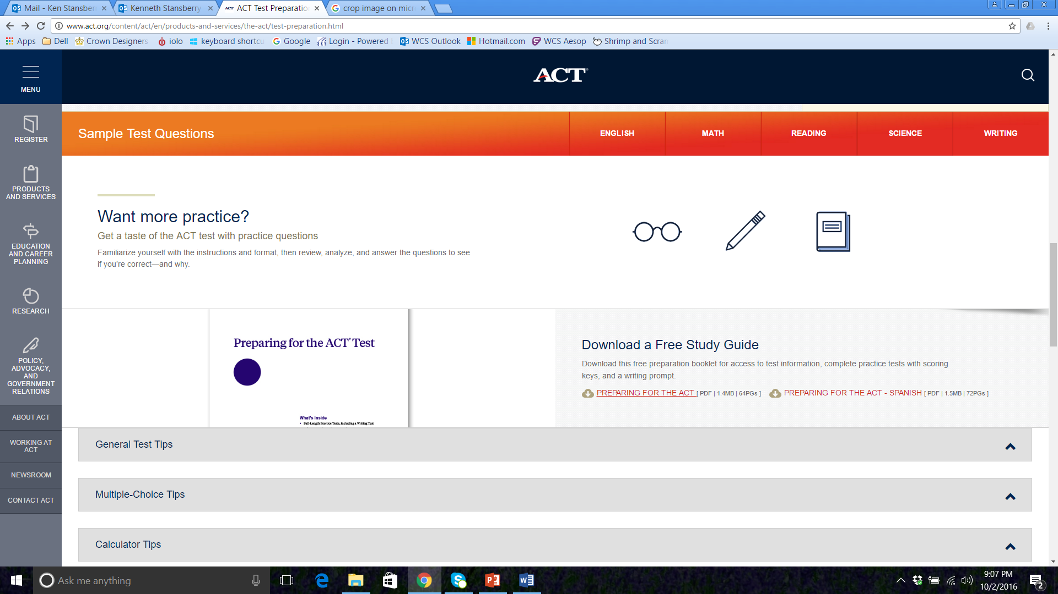
Free ACT Practice Test
®

Slide 19

English
Know the Score you need!
# Correct/75 | % Score | ACT Score | # Correct/75 | % Score | ACT Score
1 | 1% | 1 | 39 | 52% | 17
2 | 3% | 2 | 40 | 53% | 17
3 | 4% | 2 | 41 | 55% | 18
4 | 5% | 3 | 42 | 56% | 18
5 | 7% | 3 | 43 | 57% | 19
6 | 8% | 4 | 44 | 59% | 19
7 | 9% | 4 | 45 | 60% | 20
8 | 11% | 5 | 46 | 61% | 20
9 | 12% | 5 | 47 | 63% | 20
10 | 13% | 6 | 48 | 64% | 21
11 | 15% | 6 | 49 | 65% | 21
12 | 16% | 7 | 50 | 67% | 21
13 | 17% | 7 | 51 | 68% | 22
14 | 19% | 7 | 52 | 69% | 22
15 | 20% | 8 | 53 | 71% | 23
16 | 21% | 8 | 54 | 72% | 23
17 | 23% | 8 | 55 | 73% | 23
18 | 24% | 9 | 56 | 75% | 24
19 | 25% | 9 | 57 | 76% | 24
20 | 27% | 10 | 58 | 77% | 25
21 | 28% | 10 | 59 | 79% | 25
22 | 29% | 10 | 60 | 80% | 26
23 | 31% | 11 | 61 | 81% | 26
24 | 32% | 11 | 62 | 83% | 27
25 | 33% | 12 | 63 | 84% | 28
26 | 35% | 12 | 64 | 85% | 28
27 | 36% | 13 | 65 | 87% | 29
28 | 37% | 13 | 66 | 88% | 30
29 | 39% | 14 | 67 | 89% | 31
30 | 40% | 14 | 68 | 91% | 32
31 | 41% | 14 | 69 | 92% | 32
32 | 43% | 15 | 70 | 93% | 33
33 | 44% | 15 | 71 | 95% | 34
34 | 45% | 15 | 72 | 96% | 35
35 | 47% | 15 | 73 | 97% | 35
36 | 48% | 16 | 74 | 99% | 35
37 | 49% | 16 | 75 | 100% | 36
38 | 51% | 16
# Correct/75 | % Score | ACT Score
46 | 61% | 20
47 | 63% | 20
48 | 64% | 21
49 | 65% | 21
50 | 67% | 21
51 | 68% | 22
52 | 69% | 22
Notes:
Walk them through the basic structure of the test. Have them observe how many questions are required to get a particular score. Point out that perfection is not required to get a fairly competitive score.

Slide 20
English Test
Study the Trends
Master 1 Test
Pair Like Questions
Study Wrong Answers
Teach What you Know
Reference ACT Classroom Suggestions
Notes:
Point out structure: 5 Readings, 15 Questions Each = 45 Minutes (roughly 36 seconds a questions)

Slide 21
English Test
Know the Structure!
Reading I
Reading 2
Reading 3
Reading 4
Reading 5
5 Readings, 15 Questions Each
Notes:
Point out structure: 5 Readings, 15 Questions Each = 45 Minutes (roughly 36 seconds a questions)

Slide 22

ACT English Skills Chart – Don’t have to know EVERYTHING!
TOPIC | SUGGESTION
End Punctuation | Start with periods and semi-colons first
Colons and Dashes | MUST have a full sentence BEFORE them. Don’t worry so much about what follows the colon or dash
Commas | After testing any end punctuation answers, start with the answer with the most commas and work your way back to the least
Splices/Fuses | Always be aware of Comma Splices (2 sentences joined by a comma) and Fused Sentences (2 sentences placed together with no punctuation). They are ALWAYS wrong!
Verb Agreement | Find the subject that is actually doing the verb. Be sure to eliminate any intervening prepositional phrases. Verbs don’t agree with objects of prepositions.
Verb Tense | Look at the first line of the passage and match verb endings. Remember that the tense will not switch within a given passage.
Transitions | Identify the specific items that the transition seeks to connect. Ask yourself, “are these two items similar, different, sequential, cause/effect, general/specific?”
Wording | If all of the answers are differently worded and of varying lengths, choose between the two shorter answers.
“If the writer were to delete…” | Look at the passage that is to be deleted, and ask yourself what would be lost without it BEFORE looking at any of the answers. Classify the loss: details, reasons, examples, explanations
“If the writer were to add…” | Look at the first few words, and match the subject with the logical location for that subject. When presented with a “Yes/No” question, consider the focus of the paragraph being referenced.
Primary Purpose | Reread the first sentence of the passage and the last sentence of the passage. Don’t be thrown by answers that are true, but not consistent with overall focus.
Long Questions | Find the core of long questions, and avoid being distracted by the surrounding details. What is the question specifically looking for?
Apostrophes | Be sure that possessive options actually link to something possessed. Be careful not to confuse possessives with plurals or contracted words.
Who/Whom | “Who” pitches. “Whom” catches. “Who” does the verb; “Whom” receives the verb or functions as an object.
Look for pairs… | Answers can often be paired into simple choices. Make the simple choices first. Then, look at the difference between what remains.
Watch out for… | “Could of,” “Should of,” “Would of” are always wrong! Could “have,” Should “have,” Would “have,” or “Could’ve, Should’ve, Would’ve” are correct!
All things being equal… | If all things are equal, DON’T ADD WORDS!
Notes:
Point out that the test only assesses a limited set of skills . . . They will review them in the program.

Slide 23
Daily ACT Practice
®
English Test
Passage used by permission from the Barron’s ACT Guide, 15th Edition, Barron’s Educational Series, Inc., 2008
ACT is a registered trademark of Act, Inc., which was not involved in the writing of, and does not endorse, this presentation

Slide 24
ENGLISH TEST
45 MINUTES 75 QUESTIONS
Passage I
Almost everywhere spread through the British Isles are to be found antiquities. These are carefully marked on governmental, and many private maps and historians describe them in publicly available guides. Governmental agencies, the National Trust, and private landlords are most accommodating in permitting visits to these unattended sites, most of which are unsupervised yet immaculate.
Passage used by permission from the Barron’s ACT Guide, 15th Edition, Barron’s Educational Series, Inc., 2008
Notes:
You might show them how the power point will work in each session. However, you might prefer to wait on this part until the sessions actually begin. It’s entirely up to you. This is a “sell” sessions, so you determine how much or how little you want to present.

Slide 25
ENGLISH TEST
45 MINUTES 75 QUESTIONS
Passage I
Almost everywhere spread through the British Isles are to be found antiquities. These are carefully marked on governmental, and many private maps and historians describe them in publicly available guides. Governmental agencies, the National Trust, and private landlords are most accommodating in permitting visits to these unattended sites, most of which are unsupervised yet immaculate.
(A) NO CHANGE
(B) widely dispersed through
(C) throughout
(D) all over, in nook and crook
1
Passage used by permission from the Barron’s ACT Guide, 15th Edition, Barron’s Educational Series, Inc., 2008

Slide 26
ENGLISH TEST
45 MINUTES 75 QUESTIONS
Passage I
Almost everywhere spread through the British Isles are to be found antiquities. These are carefully marked on governmental, and many private maps and historians describe them in publicly available guides. Governmental agencies, the National Trust, and private landlords are most accommodating in permitting visits to these unattended sites, most of which are unsupervised yet immaculate.
(A) NO CHANGE
(B) widely dispersed through
(C) throughout
(D) all over, in nook and crook
1
Passage used by permission from the Barron’s ACT Guide, 15th Edition, Barron’s Educational Series, Inc., 2008

Slide 27
ENGLISH TEST
45 MINUTES 75 QUESTIONS
Passage I
Almost everywhere spread through the British Isles are to be found antiquities. These are carefully marked on governmental, and many private maps and historians describe them in publicly available guides. Governmental agencies, the National Trust, and private landlords are most accommodating in permitting visits to these unattended sites, most of which are unsupervised yet immaculate.
(A) NO CHANGE
(B) widely dispersed through
(C) throughout
(D) all over, in nook and crook
1
Rule: Avoid awkward or wordy sentences. NOTE: For almost all of these types of questions, choose the shortest answer!
Passage used by permission from the Barron’s ACT Guide, 15th Edition, Barron’s Educational Series, Inc., 2008

Slide 28
English Test
Know the basics!
The Single Comma
Suddenly questioning the physics of bungee cord design
,
Bob hesitated to take the few steps towards the edge of the platform.
The Basic Rule: S , I one side must be a sentence
Notes:
Point out structure: 5 Readings, 15 Questions Each = 45 Minutes (roughly 36 seconds a questions)

Slide 29
English Test
Know the basics!
The Single Comma
The Reverse is also true…
Bob hesitated to take the few steps towards the edge of the platform
,
suddenly questioning the physics of bungee cord design.
The Basic Rule: S , I one side must be a sentence
Notes:
Point out structure: 5 Readings, 15 Questions Each = 45 Minutes (roughly 36 seconds a questions)

Slide 30
English Test
Know the basics!
While we’re looking at punctuation…
,
The test presented unexpected challenges
questions that were formatted differently than previous tests.
The Basic Rule: S , I one side must be a sentence
Notes:
Point out structure: 5 Readings, 15 Questions Each = 45 Minutes (roughly 36 seconds a questions)

Slide 31
English Test
Know the basics!
While we’re looking at punctuation…
:
The test presented unexpected challenges
Questions that were formatted differently than previous tests.
The Basic Rule: S : / – I/S Sentence MUST precede colon, or dash. What follows doesn’t matter.
Notes:
Point out structure: 5 Readings, 15 Questions Each = 45 Minutes (roughly 36 seconds a questions)

Slide 32
English Test
Know the basics!
While we’re looking at punctuation…
–
The test presented unexpected challenges
Questions that were formatted differently than previous tests.
The Basic Rule: S : / – I/S Sentence MUST precede colon, or dash. What follows doesn’t matter.
Notes:
Point out structure: 5 Readings, 15 Questions Each = 45 Minutes (roughly 36 seconds a questions)

Slide 33
English Test
Know the basics!
Combining Sentences
I like you.
I think you are nice.
;
I like you
I think you are nice.
I like you
; however,
you could be nicer.
Conjunctive Adverbs: However, Although, Therefore, Whereas
Notes:
Point out structure: 5 Readings, 15 Questions Each = 45 Minutes (roughly 36 seconds a questions)

Slide 34
English Test
Know the basics!
Combining Sentences
Conjunctive Adverbs: When do I just use commas?
INTERRUPTS
When the “however” a sentence
You could
, however,
be nicer.
Only 1 sentence here . . . Not about combining!
Notes:
Point out structure: 5 Readings, 15 Questions Each = 45 Minutes (roughly 36 seconds a questions)

Slide 35
English Test
Know the basics!
Combining Sentences
I like you.
I think you are nice.
, and
I like you
I think you are nice.
*FANBOYS: for, and, nor, but, or, yet, so
NOTICE: FANBOYS Get Commas!
Notes:
Point out structure: 5 Readings, 15 Questions Each = 45 Minutes (roughly 36 seconds a questions)

Slide 36
English Test
Know the basics!
Combining Sentences
I like you.
I think you are nice.
I like you
because
I think you are nice.
*because, while, as, if, when
NOTICE: No Comma!
Notes:
Point out structure: 5 Readings, 15 Questions Each = 45 Minutes (roughly 36 seconds a questions)

Slide 37
English Test
Know the basics!
Combining Sentences
_________ _________
_________ _________
_________ _________
_________ _________
_________ _________
.
.
;
.
; however,
.
, and
.
because
.
Notes:
Point out structure: 5 Readings, 15 Questions Each = 45 Minutes (roughly 36 seconds a questions)

Slide 38
English Test
Know the basics!
Combining Sentences
What about . . .
I like you, I think you are nice.
or
I like you I think you are nice.
Never Acceptable!
Notes:
Point out structure: 5 Readings, 15 Questions Each = 45 Minutes (roughly 36 seconds a questions)

Slide 39
English Test
Know the basics!
Combining Sentences
Comma Splices and Fused Sentences
I like you, I think you are nice.
,
.
.
_________ _________
_________ _________
;
.
I like you I think you are nice.
Again, Never Acceptable!
Seriously, Never! ... Ever!
Notes:
Point out structure: 5 Readings, 15 Questions Each = 45 Minutes (roughly 36 seconds a questions)

Slide 40
English Test
Know the basics!
COMMAS!
They’re easier than you think!
Just 3 Rules!
FANBOYS Sentences
Items in a Series
Isolating words/phrases
Notes:
Point out structure: 5 Readings, 15 Questions Each = 45 Minutes (roughly 36 seconds a questions)

Slide 41
English Test
Know the basics!
Remember, FANBOYS?
I like you.
I think you are nice.
, and
I like you
I think you are nice.
*FANBOYS: for, and, nor, but, or, yet, so
FANBOYS Get Commas!
Notes:
Point out structure: 5 Readings, 15 Questions Each = 45 Minutes (roughly 36 seconds a questions)

Slide 42
English Test
Know the basics!
“,and” can only be correct in
2 situations!
Combined “FANBOYS” Sentences
_________ _________
Items in a Series
______ ______ ______
, and
.
,
, and
.
Notes:
Point out structure: 5 Readings, 15 Questions Each = 45 Minutes (roughly 36 seconds a questions)

Slide 43
English Test
Watch for Parallel Structure!
Know the basics!
Items in a series!
Simple Series
I like value respect you
Phrases in a Series
I like to swim in the morning to bike to school to workout in the evening
,
, and
.
_________
,
________
, and
___
_________
.
Notes:
Point out structure: 5 Readings, 15 Questions Each = 45 Minutes (roughly 36 seconds a questions)

Slide 44
English Test
Watch for Parallel Structure!
Know the basics!
Items in a series!
Simple Series
I’m amazed confused overwhelmed
Clauses in a Series
I dream of hiking the expanse of the AT
rappelling from the face of rocky cliffs
sleeping under the great expanse of the night
sky I know my skills need
nurturing I need to be honest
about my limitations
__
,
, and
.
__
__
_____
,
________
, and
______
; however
, and
.
Notes:
Point out structure: 5 Readings, 15 Questions Each = 45 Minutes (roughly 36 seconds a questions)

Slide 45
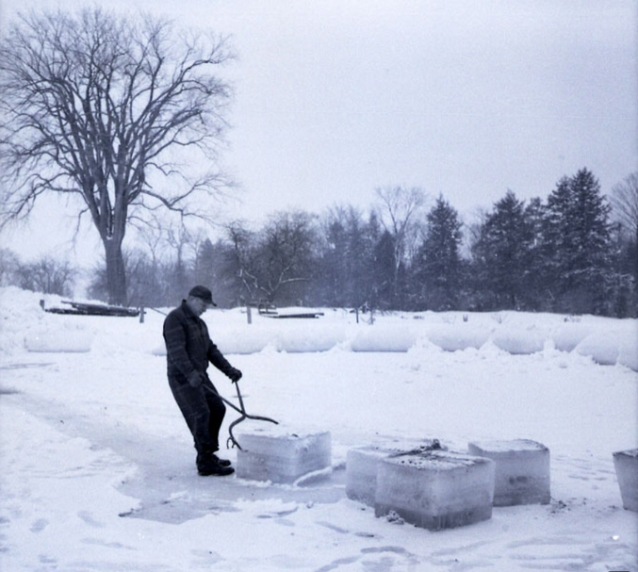

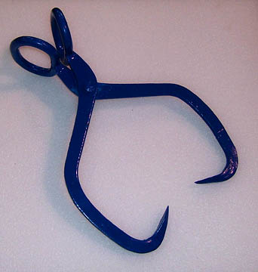
English Test
Know the basics!
That other rule: Ice Tongs!
Notes:
Point out structure: 5 Readings, 15 Questions Each = 45 Minutes (roughly 36 seconds a questions)

Slide 46
English Test
Know the basics!
That other rule: Ice Tongs!
Should I stay, or should I go?
Any student , who studies hard , will do well.
Any student who studies hard will do well.
Notes:
Point out structure: 5 Readings, 15 Questions Each = 45 Minutes (roughly 36 seconds a questions)

Slide 47
English Test
Know the basics!
That other rule: Ice Tongs!
Should I stay, or should I go?
Any student will do well.
Any student who studies hard will do well.
who studies hard
Notes:
Point out structure: 5 Readings, 15 Questions Each = 45 Minutes (roughly 36 seconds a questions)

Slide 48
English Test
Know the basics!
That other rule: Ice Tongs!
Should I stay, or should I go?
Any student , who studies hard , will do well.
Any student who studies hard will do well.
Notes:
Point out structure: 5 Readings, 15 Questions Each = 45 Minutes (roughly 36 seconds a questions)

Slide 49
English Test
Know the basics!
That other rule: Ice Tongs!
Should I stay, or should I go?
True, also, for single words…
I lived in Knoxville , Tennessee before moving to Franklin.
Notes:
Point out structure: 5 Readings, 15 Questions Each = 45 Minutes (roughly 36 seconds a questions)

Slide 50
English Test
Know the basics!
That other rule: Ice Tongs!
Should I stay, or should I go?
True, also, for single words…
I lived in Knoxville , Tennessee , before moving to Franklin.
We travel in pairs on the ACT!
Unless the period ends the parenthetical word or phrase!
Notes:
Point out structure: 5 Readings, 15 Questions Each = 45 Minutes (roughly 36 seconds a questions)

Slide 51
English Test
Know the basics!
That other rule: Ice Tongs!
Should I stay, or should I go?
I used to live lived in Knoxville , Tennessee .
The funniest animal that I’ve ever met is Maggie Lu , my silly Chihuahua .
We travel in pairs on the ACT!
Unless the period ends the parenthetical word or phrase!
Notes:
Point out structure: 5 Readings, 15 Questions Each = 45 Minutes (roughly 36 seconds a questions)

Slide 52
English Test
Know the basics!
COMMAS!
See, it’s simple really…
Just 3 Rules!
FANBOYS Sentences
Items in a Series
Isolating words/phrases
Notes:
Point out structure: 5 Readings, 15 Questions Each = 45 Minutes (roughly 36 seconds a questions)

Slide 53
Reading
Know the Score you need!
# Correct/40 | % Score | ACT Score
0 | 0% | 1
1 | 3% | 2
2 | 5% | 4
3 | 8% | 6
4 | 10% | 7
5 | 13% | 8
6-7 | 18-15% | 10
8 | 20% | 11
9-10 | 23-25% | 12
11 | 28% | 13
12-13 | 30-33% | 14
14 | 35% | 15
15-16 | 38-40% | 16
17 | 43% | 17
18 | 45% | 18
19-20 | 48-50% | 19
21 | 53% | 20
22-23 | 55-58% | 21
24 | 60% | 22
25-26 | 63-65% | 23
27 | 68% | 24
28 | 70% | 25
29 | 73% | 26
30 | 75% | 27
31 | 78% | 28
32 | 80% | 29
33 | 83% | 30
34 | 85% | 31
35 | 88% | 32
36 | 90% | 32
37 | 93% | 33
38 | 95% | 34
39 | 98% | 35
40 | 100% | 36
# Correct/40 | % Score | ACT Score
18 | 45% | 18
19-20 | 48-50% | 19
21 | 53% | 20
22-23 | 55-58% | 21
24 | 60% | 22
25-26 | 63-65% | 23
27 | 68% | 24
Notes:
Point out that they can miss almost half of the questions and still get a 21!

Slide 54

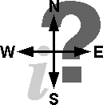
Be on the lookout!
The answers are easier to find than you might imagine!

Slide 55
Form
Where the Answers Live…
Introduction
Setting
Characters
Thesis
Predictors
Falling Action
New Resolve
Strategy
Innovation
Conflict
Climax
Turning Point
Major Barrier
Red Herring
Conclusion
Theme
Epiphany
Reflection
Summary
Notes:
Tell them that we will help them know how to SCAN reading. They have 4 readings, 10 questions each, only 35 minutes. Thorough reading won’t work!

Slide 56
4 Readings – 10 Questions Each
PROSE FICTION
SOCIAL SCIENCE
HUMANITIES
NATURAL SCIENCE
Plot
Exposition
Conflict Development
Resolution
Setting
Mood
Character
Tone
Style
Key Names
Dates
Cause/Effect
Chronology
Tone
Social Controversies
Social Context
Biography
Historical
Contemporary
Historical Context
Artistic Context
Period/Genre
Chronology
Exemplification
Tone
Problem Solution
Verifiable Facts
Scientific Theories
Cause/Effect
Comparison/
Contrast
Steps in Sequence
Prominent Scientists
Applications
Notes:
When they learn that each reading has a focus/formula, they will know better how to scan the passages.

Slide 57
What it is |  | What you can expect
Prose Fiction | Excerpts from novels or short stories Most passages are contemporary, emphasize diversity, and often center on family relationships. | Setting, atmosphere, and the relationships between characters are more important than facts Questions likely to involve identifying the implied meanings vs. what was directly stated
Social Science | Topics: anthropology, archaeology, biography, business, economics, education, geography, history, political science, psychology, and sociology | Organization flows logically with clear topic sentences and well-chosen transitions to develop the main idea Author may have a point of view on the subject or may simply deliver informative facts in a neutral tone
Humanities | Nonfiction passages—usually memoirs or personal essays Topics: architecture, art, dance, ethics, film, language, literary criticism, music, philosophy, radio, television, and theater | Narrative may use a more organic development instead of a linear one Tone will be more personal and perhaps more emotional
Natural Science | Topics: anatomy, astronomy, biology, botany, chemistry, ecology, geology, medicine, meteorology, microbiology, natural history, physiology, physics, technology, and zoology | Lots of details and sometimes very technical descriptions Linear organization with clear topic sentences and transitions to develop the main idea Author may or may not have an opinion on the topic Questions usually track the text pretty closely and require you to make few inferences

Slide 58


Reading Tips:
ACT Reading Tip: Follow the recommended ACT reading comprehension method
1. Read the passage and write short notes next to each
paragraph.
-Focus on the topic and purpose of the passage
-Keep track of different people and opinions
2. Read the question and identify helpful hints.
-Line references and keywords can help you find the
answer
3. Predict an answer BEFORE you look at the answer choices.

Slide 59
Reading Tips:
ACT Reading Tip: Know the ACT reading comprehension question types
Main Idea questions – Ask about the passage as a whole
Inference & Writer’s View questions – Ask you to
understand something that isn’t directly stated in the passage
Detail questions – Ask about specific parts of the passage
Vocab-in-Context questions – Ask about a word as it is used
in the passage
Function questions – Ask about the purpose of a specific
part of the passage

Slide 60
Reading Tips:
ACT Reading Tip: Know the ACT reading comprehension trap answers
1. Distortion – twists details from the passage so they are no
longer correct
2. Misused detail – a true statement from the passage, but one
that doesn’t answer the question
3. Out-of-scope – includes information not included in the
passage
4. Extreme – too extreme to reflect the author’s purpose (often
includes words like always, never, best, worst, etc.)
5. Opposite – contradicts the information in the passage

Slide 61
1. Find the author’s point of view as you read
Do you find yourself getting lost in the details, or reading too quickly and missing some of the important information? For the ACT Reading Test, you’ve got to strike a balance between reading for the author’s point of view and for the function of each paragraph, while also noting the location of important details in case you need to come back later. How do you do all of this at the same time?
2. Make sure you underline anything that seems significant to you
Look for words and phrases that reveal the author’s opinion, or give the main idea of each paragraph. The test booklet is basically one large piece of scratch paper, so it doesn’t matter if you write all over it. In fact, it’s better if you do! Underline, circle, write 3-5 word summaries of each paragraph…whatever works for you. Just don’t get so carried away with the note taking that you run out of time…

Slide 62
3. Time yourself as you practice
If you are spending more than 3 minutes reading and marking passages, you are risking not being able to finish all of the questions on test day. As you become more and more confident with your accuracy, try to get as precise as possible with the timing of your note taking.
4. Do at least ten ACT Reading practice tests
Full-length practice tests are available in ACT practice books at local bookstores, at your local library, and are even downloadable online. Find a quiet place where you can take the practice ACT, and clear off the table or desk. Try and eliminate any distractions and do the best you can to mimic your test-day environment. Keep a clock or timer in front of you so you can periodically check and see how you are doing. You may want to set the timer to go off every 9-10 minutes. Don’t rush, but make sure you can move confidently from one passage to the next and answer ALL questions in the time allotted.

Slide 63
5. For Vocabulary in Context questions, go back to the passage
A commonly used vocab word often takes on a secondary definition within ACT passages. Do not assume that the common meaning is the correct answer; there may be several meanings you do not know. Go back to the passage and see how the word is being used in context.
6. Always pre-phrase an answer
Before you look at the answer choices, use the passage to predict your own answer. Then match your prediction to the answer choices. This will save you time. Don’t get stuck weighing answer choices. Cross out all answer choices that don’t match your prediction, pick the best available answer, and move on!
7. Dumb down complicated questions
If you read a question and it is confusing or unclear to you, rephrase it in simpler terms. Think of it as though you were going to explain the question to a small child. What is it really asking?

Slide 64
8. After 9 minutes, move on to the next passage
The ACT Reading Test is 35 minutes long and contains 40 questions (10 questions oin each passage). This means you’ll have slightly less than 9 minutes to spend on each of the 4 passages, so pacing yourself is essential.
9. Do the passages in any order
You will always see 4 passages and you must always answer all 40 questions (even if you just guess – the ACT does not penalize you for wrong answers!) But that doesn’t mean you have to approach the passages in the order in which they are presented on the test. As you practice, you will start to realize which passages are easier and which are more challenging for you. For example, if Prose Fiction is your strong point but Natural Science passages make you nervous, it may make sense for you to do the Prose Fiction passage first and save the Natural Science passage for last. Just make sure you’re bubbling in the write question number on your answer sheet…
10. Bubble your answer carefully
If you do decide to skip around, make sure you are still bubbling your answers
into the corresponding numbers on the answer grid. You don’t want to
lose points because you bubbled incorrectly!

Slide 65

Math – 60 Questions
Know the Score you need!
# Correct/60 | % Score | ACT Score | # Correct/75 | % Score | ACT Score
1 | 2% | 3 | 39 | 65% | 25
2 | 3% | 6 | 40 | 67% | 25
3 | 5% | 7 | 41 | 68% | 26
4 | 7% | 9 | 42 | 70% | 26
5 | 8% | 10 | 43 | 72% | 27
6 | 10% | 11 | 44 | 73% | 27
7 | 12% | 11 | 45 | 75% | 27
8 | 13% | 12 | 46 | 77% | 28
9 | 15% | 13 | 47 | 78% | 28
10 | 17% | 13 | 48 | 80% | 29
11 | 18% | 13 | 49 | 82% | 29
12 | 20% | 14 | 50 | 83% | 30
13 | 22% | 14 | 51 | 85% | 30
14 | 23% | 14 | 52 | 87% | 31
15 | 25% | 15 | 53 | 88% | 31
16 | 27% | 15 | 54 | 90% | 32
17 | 28% | 15 | 55 | 92% | 33
18 | 30% | 16 | 56 | 93% | 34
19 | 32% | 16 | 57 | 95% | 34
20 | 33% | 16 | 58 | 97% | 35
21 | 35% | 16 | 59 | 98% | 35
22 | 37% | 17 | 60 | 100% | 36
23 | 38% | 17
24 | 40% | 17
25 | 42% | 18
26 | 43% | 18
27 | 45% | 19
28 | 47% | 19
29 | 48% | 19
30 | 50% | 20
31 | 52% | 21
32 | 53% | 21
33 | 55% | 22
34 | 57% | 22
35 | 58% | 23
36 | 60% | 23
37 | 62% | 24
38 | 63% | 24
# Correct/60 | % Score | ACT Score
29 | 48% | 19
30 | 50% | 20
31 | 52% | 21
32 | 53% | 21
33 | 55% | 22
34 | 57% | 22
35 | 58% | 23
Notes:
The Math test is the most time-friendly. They get a full minute for each question, and the good news: they only have to get one more than half to get a 21!

Slide 66
Math – 60 Questions
Slay the beasts you can!
31 questions = 21 Score
Integrating Essential Skills
25 Questions
Algebra
8 Questions
Functions & Geometry
8 Questions
8 Questions
Number & Quantity
5 Questions
Statistics & Probability
6 Questions
Notes:
When students calculate that they only need 31 questions to get the 21, they can get more strategic about how they handle the tough questions. Trigonometry . . . Only 4 questions!

Slide 67
ACT Math Strategies
Know your number. Score=number correct
Know the breakdown of Math content.
Blitz the 1st 20: ‘Gain 10 minutes’
Complete 1-20 in 10 minutes
Complete 21-40 in 20 minutes
Complete 41-60 in 30 minutes
4) Word Problems: Read last sentence first.
Reduce your problems. Divide the practice test into sections and time yourself.
Recognize ‘Plug and Chug’.
Work 1 page at a time: work all the problems on one page then bubble
in. Don’t break your ‘groove’.
Review formulas.
Highlight missed problems on practice test and ‘own’ them. Know why
you missed those problems.
Guess the same letter (ex. C) for all questions you don’t know answer.
Eliminate Answers

Slide 68
ACT©
Question Analysis
ACT – 1874FPRE
My Name My Partner’s Name

Slide 69
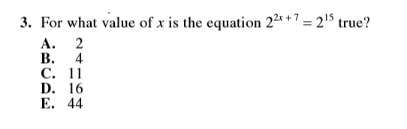

Slide 70
Math Test
X/! | Letter | Explanations for Questions #
X
X
X
X
!
TIP! This question is really a simple Math question about determining the value of “x” in an equation. Because the exponents need to equal 15, I simply need to subtract 7 from 15 with leaves me with 8. if 2x = 8, then “x” must equal 4
3
A
If I plug “2” into the equation, I would find that 2x + 7 equals 11, not 15
C
If I plug “11” into the equation, I would find that 2x + 7 equals 29, not 15. Obviously, any answer that exceeds letter “C” would have to be wrong!
D
If I plug “16” into the equation, I would find that 2x + 7 equals 39, not 15. Again, because this answer is greater than “C,” it has to be wrong!
E
If I plug “44” into the equation, I would find that 2x + 7 equals 95, not 15. Again, because this answer is greater than “C,” it has to be wrong!
B
If I plug “4” into the equation, I would find that 2x would equal 8, 8 + 7 equals 15, giving me my correct answer

Slide 71
Science & Logic
Know the Score you need!
# Correct/40 | % Score | ACT Score
0 | 0% | 1
1 | 3% | 3
2 | 5% | 5
3 | 8% | 7
4 | 10% | 8
5 | 13% | 9
6 | 15% | 10
7 | 18% | 11
8 | 20% | 12
9 | 23% | 13
10-11 | 25-28% | 14
12 | 30% | 15
13 | 33% | 16
14-15 | 35-38% | 17
16-17 | 40-43% | 18
18-20 | 45-50% | 19
21-22 | 53-55% | 20
23-24 | 58-60% | 21
25-26 | 63-65% | 22
27-28 | 68-70% | 23
29 | 73% | 24
30-31 | 75-78% | 25
32-33 | 80-83% | 26
34 | 85% | 27
35 | 88% | 28
36 | 90% | 29
37 | 93% | 30
38 | 95% | 32
39 | 98% | 34
40 | 100% | 36
# Correct/40 | % Score | ACT Score
20 | 50% | 19
21 | 53% | 20
22 | 55% | 20
23 | 58% | 21
24 | 60% | 21
25 | 63% | 22
26 | 65% | 22
27 | 68% | 23
Notes:
Let them know that Science and Logic are nothing more than Reading + Charts/Graphs

Slide 72
Science & Logic
Look out for TRENDS!
Notes:
They key to good answers on the Science and Logic is simply looking for increase, decrease, comparison, or contrast. When the data moves, the answers shout.

Slide 73
ACT
Science & Reasoning
No Graphic! Yikes!

Slide 74
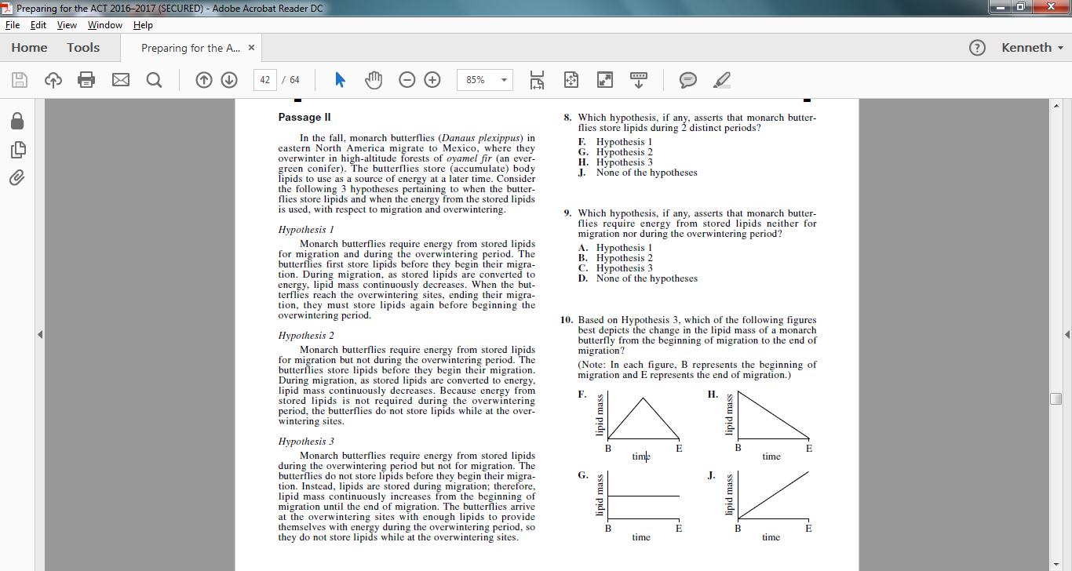

Slide 75
M
OW
WOW
1
2
3

Slide 77

M
OW
WOW
1
2
3

Slide 79
M
OW
WOW
1
2
3

Slide 81
 | M | OW | WOW
1
2
3

Slide 82
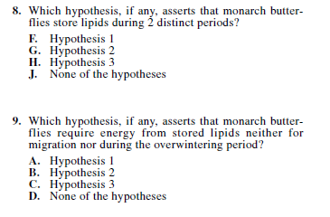

Slide 83
 | M | OW | WOW
1
2
3

Slide 85
 | M | OW | WOW
1
2
3

Slide 87
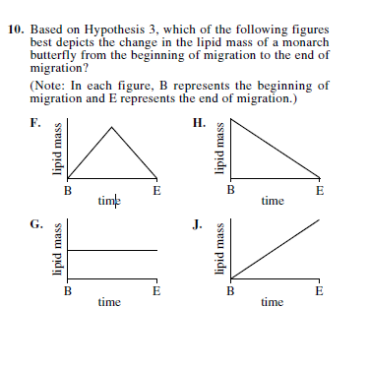

Slide 90
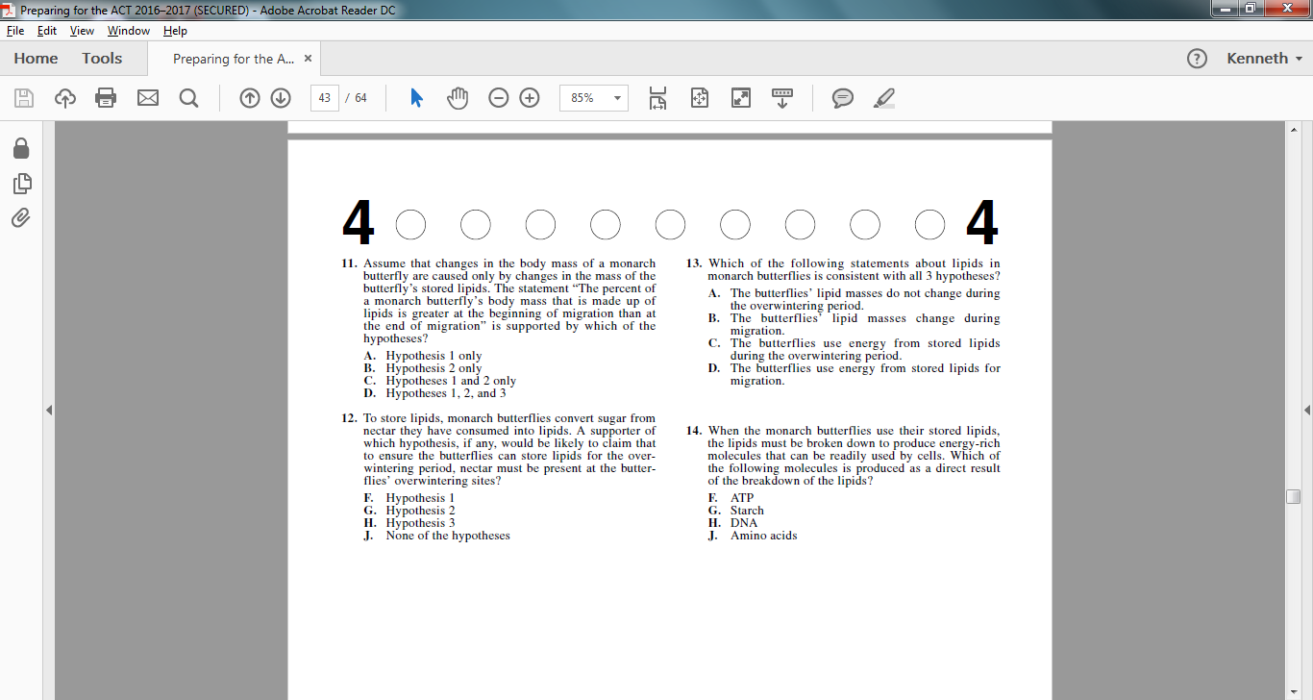

Slide 95

 | M | OW | WOW
1
2
3

Slide 98
 | M | OW | WOW
1
2
3

Slide 101


Where do we start?
Be Honest
Ask
Problem Solve Hurdles
Practice, Practice, Practice
Teach someone else what you learn
If you really want to score well. . .
simply practice more!
It’s easier than you think. . . PROMISE!

Slide 102


“Are we just learning to take a test?”
Good Question . . .

Slide 103

No!
* Problem Solving
* Time Management
* Research
* Organization
* Preparation
* Confidence
We’re Learning:

Slide 104
ACT
®
The
Check out the website:
www.act.org
Sample Tests & Test Help
Research & College Readiness
Question of the Day
Resources & Reports
Notes:
Pull up the website and show students where they can find helpful information.

Slide 105

ACT
®
Notes:
Pull up the website and show students where they can find helpful information.

Slide 106
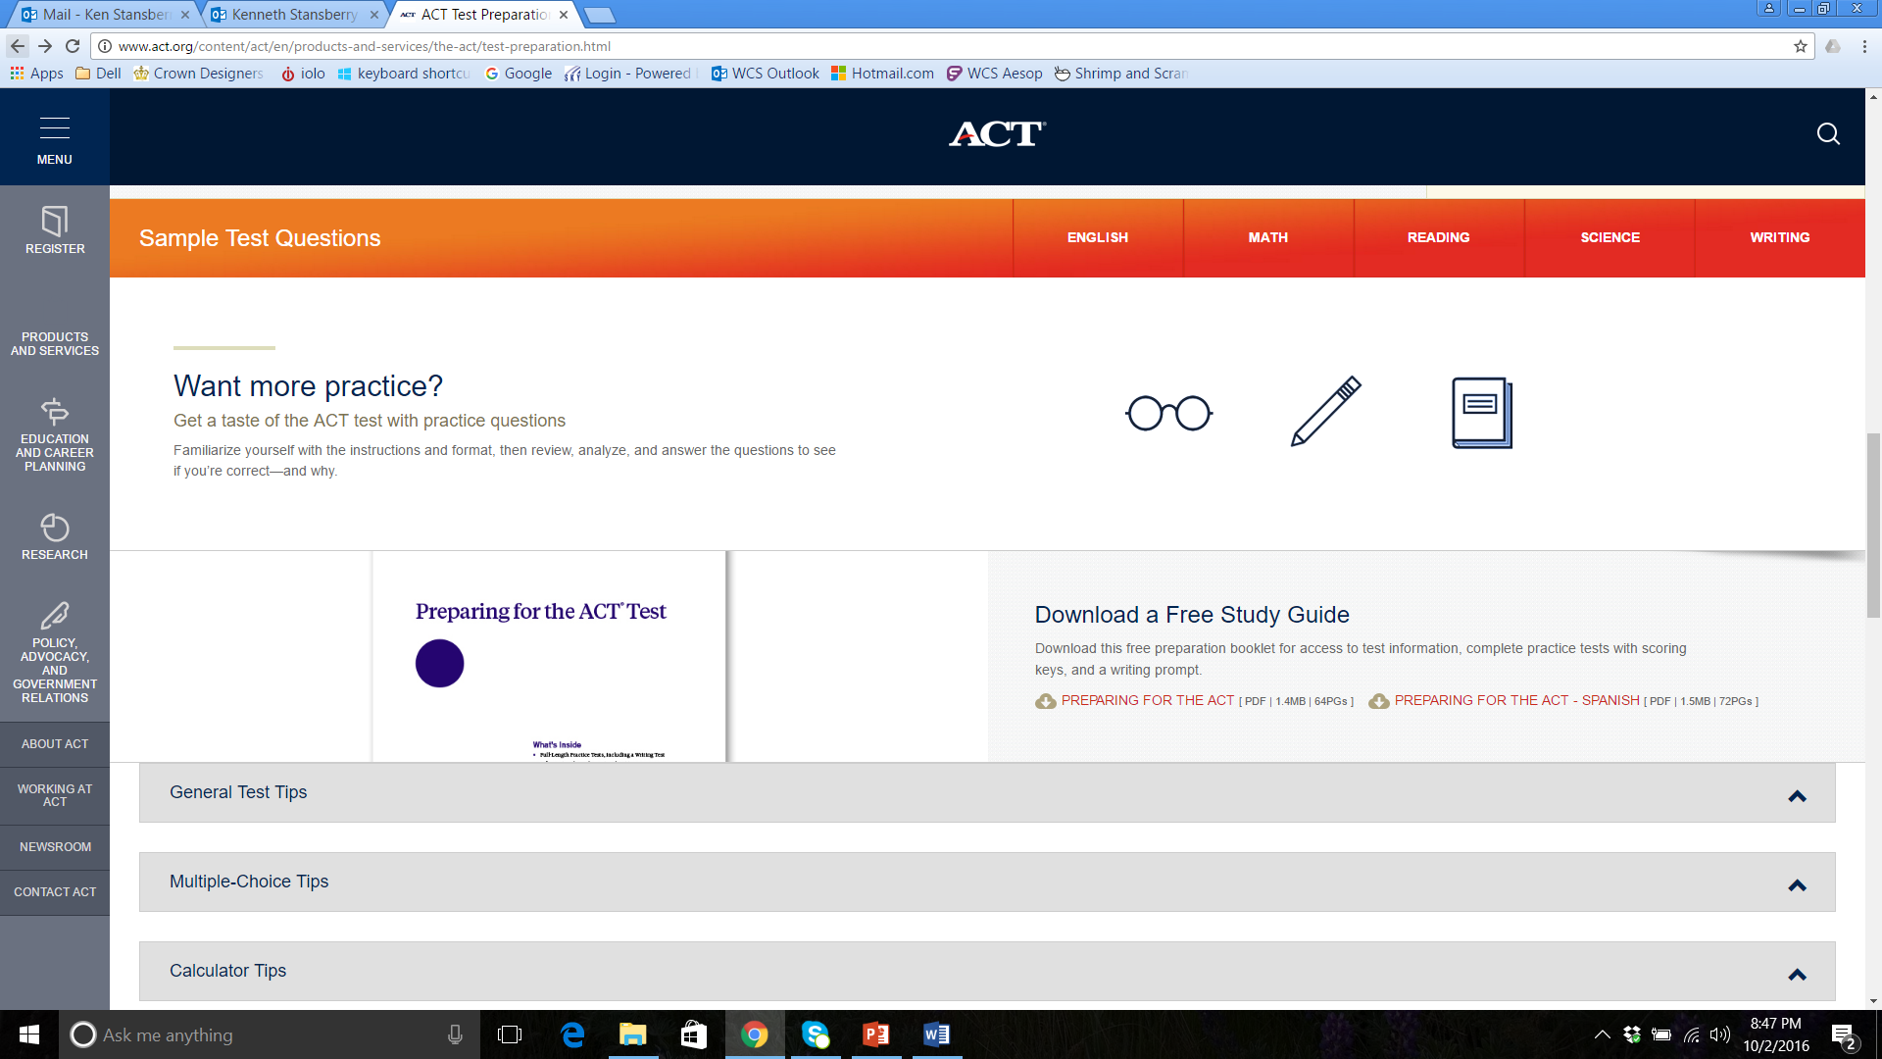
ACT
®
Notes:
Pull up the website and show students where they can find helpful information.

Slide 107
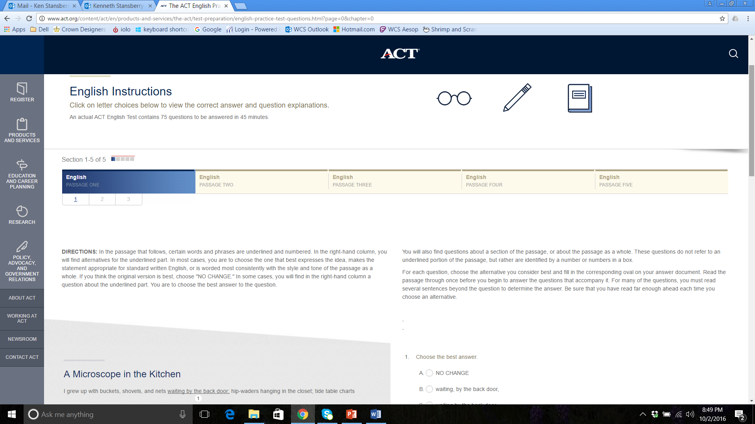
ACT
®
Notes:
Pull up the website and show students where they can find helpful information.

Slide 108
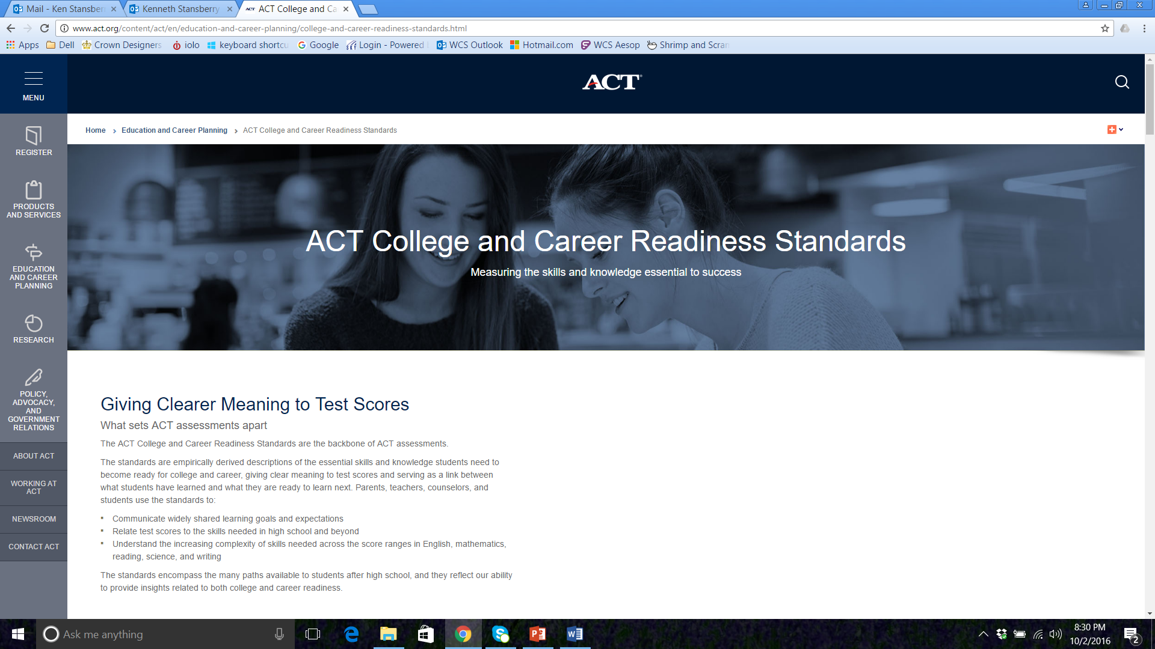


communicate widely shared learning goals and educational expectations
relate the test scores to the types of skills needed for success in high
school and beyond
understand the increasing complexity of skills across the score ranges in
English, mathematics, reading, and science

Slide 109
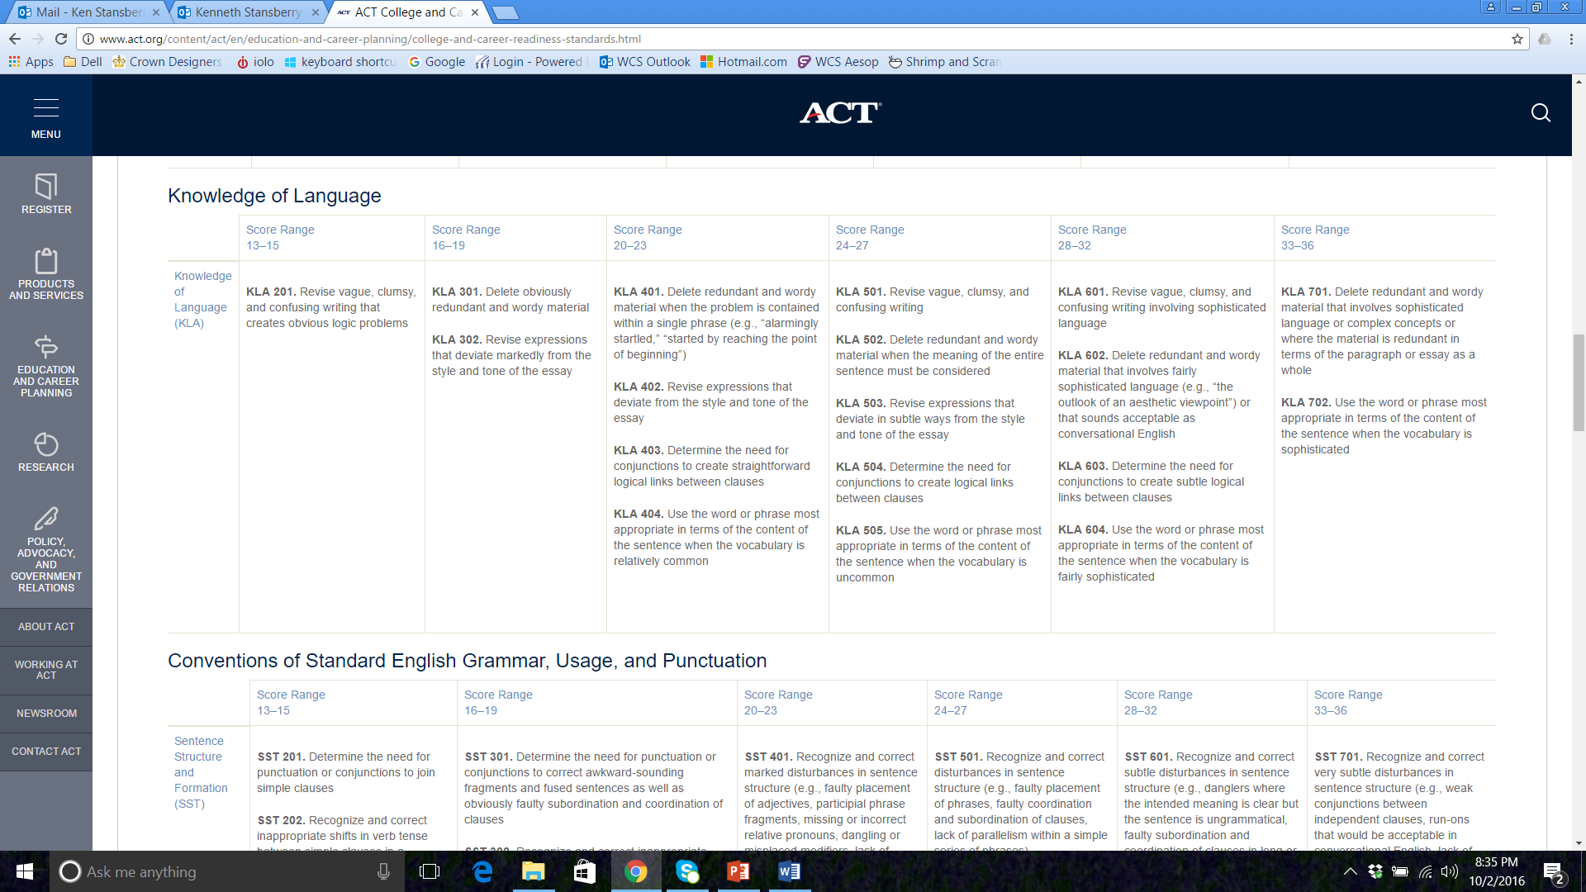

Slide 110


It’s Your Turn!
Don’t head to the game without practicing!
“The world’s a stage, and most of us are desperately unrehearsed.”
Sean O’Casey

